Slide 1
Adult Social Care
Workforce Data Set
(ASC-WDS)
Notes:
NOTE: remember you also have the ASC-WDS walk through clips and narratives which you can save locally and use if you want to show the look and feel of the new service

Slide 2
What is ASC-WDS?
The Adult Social Care Workforce Data Set (ASC-WDS) is an online data collection service that covers the adult social care workforce in England. It was previously known as the National Minimum Data Set for Social Care (NMDS-SC)
There are over 20,000 care locations in the ASC-WDS providing data on over 700,000 care staff
https://asc-wds.skillsforcare.org.uk
Notes:
It's the leading source of workforce information for the whole adult social care sector. Social care employers open accounts and enter worker information into the ASC-WDS.

Slide 3
What do Skills for Care do with ASC-WDS data?
We’re commissioned by the Department of Health and Social Care to collect data on adult social care providers and their workforce via the Adult Social Care Workforce Data Set. For over 10 years we’ve turned this data into intelligence and insight that's relied upon by the Government and across our sector.
Notes:
We publish a range of data and reports, much of which you are able to view as visualisations, and interrogate to find national, regional and local, specific information.
The government, the Department of Health and Social Care, the Care Quality Commission (CQC), local authorities, Clinical Commissioning Groups (CCGs) and other sector stakeholders all need access to high quality adult social care workforce information. The ASC WDS is where they come to get it.

Slide 4
How do I set up my ASC-WDS account?
It’s quick and straightforward to open an account and join ASC-WDS
To set up an account click
https://asc-wds.skillsforcare.org.uk and then click on ‘Create an account’.
If you’re having any difficulties logging in or setting up an account, please contact our support team for help
email: ascwds-support@skillsforcare.org.uk or call 0113 241 0969.

Slide 5
Why sign up?
7 key reasons
Store your training and qualifications in one place
Get alerts when you need to update training or you have gaps in your mandatory training
Use Training report and Benchmarks as evidence with CQC and LAs
Get access to WDF
Use benchmark to add context to recruitment and retention issues.
Understand how your business is performing on key workforce metrics (Benchmarks and beyond)
Help the sector by providing key intelligence to decision makers (Government, DHSC, LAs).
Notes:
New reasons added as new functionalities come online. If you would like the system to do something, please use the beta button on the main home screen and give us your feedback.

Slide 6
Why sign up?
Training and Qualifications:
Record all your staff training and qualifications.
Receive alerts for mandatory updates for training.
Identify where staff need refresher training and manage the planning of staff learning and development which so you can make informed decisions about what to commission from learning providers.
Quickly download training summaries to use as evidence with CQC and Local Authority Commissioners

Slide 7
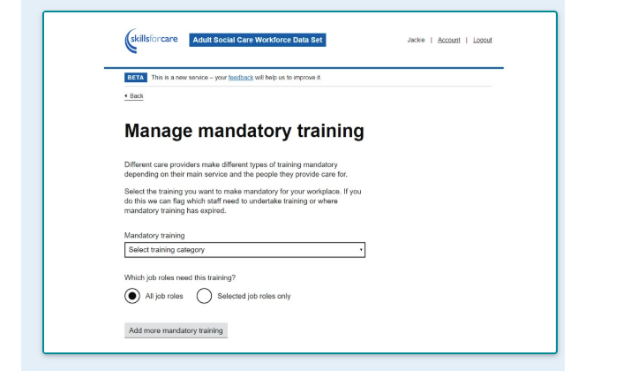
Mandatory Training
You can define what training is mandatory for specific job roles; the service will flag where mandatory training needs refreshing or where workers haven’t undertaken this training
Notes:
The excel format report provides a summary of your staff training and highlights staff who have training that has, or will soon expire or where required training is missing. It’s a valuable management tool to ensure staff training is up to date and helps you plan future training, giving you access to relevant information needed before commissioning training from a provider. You can also use it to evidence with CQC that all training is up to date.

Slide 8
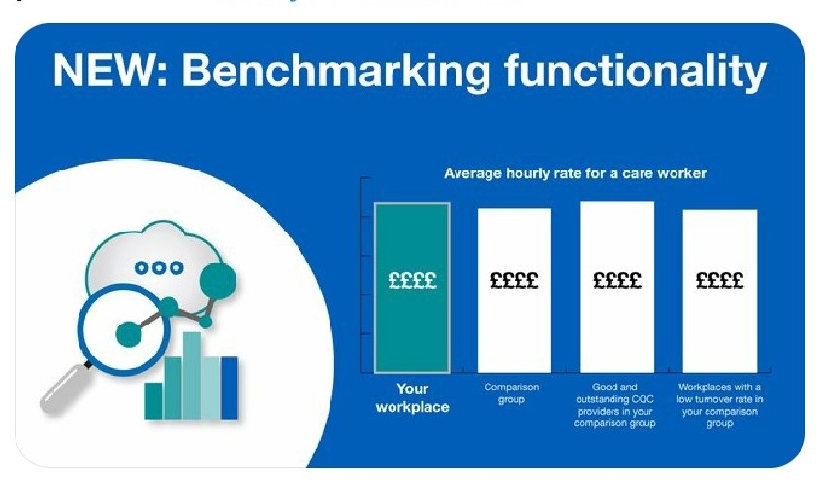
Hot off The Press
Explore the New Functionality with at a glance Key Workforce Information Benchmarking against other providers

Slide 9
What is the Workforce Development Fund
A financial contribution towards the cost of workers completing a range of adult social care qualifications and learning programmes, meaning you can claim back a proportion of the costs incurred on completion of the learning.
A list of funded qualifications and learning programmes and their funding value is available: www.skillsforcare.org.uk/WDFqualifications
Here are some examples of what you could claim:
Level 2 Diploma in Health and Social Care –£600 (Apprenticeship £1000)
Level 3 Diploma in Health and Social Care – £800 (Apprenticeship £1300)
Level 4 Diploma in Adult Care – £1050 (Apprenticeship £1550)
End of life care Awareness learning programme - £140
Level 5 Diploma Leader in Adult Care £1500 (Apprenticeship £2000)
You need to have an ASC-WDS account as part of the eligibility criteria

Slide 10
Direct Access
Apply directly to Skills for Care if your area doesn’t
have a WDF partnership
www.skillsforcare.org.uk/directaccess
Complete and submit a direct access declaration form
Sign a grant letter
National partnerships
www.skillsforcare.org.uk/wdf
Areas using Direct Access are South Yorkshire, North East Lincs, North Lincs, Hull, East Riding, Northumberland, Darlington, Hartlepool, Middlesbrough, Redcar and Cleveland and Stockton on Tees.
Notes:
Handout form
Mention SY partnership and National
Areas for Direct Payments South Yorkshire, North East Lincs, North Lincs, Hull, East Riding, Northumberland, Darlington, Hartlepool, Middlesbrough, Redcar and Cleveland and Stockton on tees.

Slide 11
Help us represent you to the government, DHSC, CQC and key sector bodies
Local authorities use the data to make decisions around funding and for their market position statements and resource management. By analysing our data, we’ve been able to help in a project to provide priority online shopping slots at Iceland – benefitting up to one million adult social care staff.
Notes:
DHSC uses the data: if you’re an ASC-WDS user then your information is being used to better understand the issues affecting the sector and to help the Government develop policies to address them. This has led to national level policies such as Value Based Recruitment and the current ‘Everyday is Different’ campaign.
These are direct links from your data being input into ASC-WDS to direct action by DHSC and the Government.

Slide 12
Local Authority Area Information
Using our interactive visualisation tools, you will be able to compare two or more Local Authorities to find out lots of useful information across different areas, or you can look at one Local Authority at a time to get more detailed information on that area.
Much of adult social care is commissioned at a local level which is why we have specific local level reports and information. Local Authorities, Clinical Commissioning Groups (CCGs), Local Workforce Action Boards (LWABs) and Integrated Care Systems (ICS) all use the ASC-WDS data to help them undertake workforce planning.
Notes:
LINKS:
Regional information: Each regional page contains; an adult social care sector and workforce report; an interactive visualisation; key findings. further resources.
https://www.skillsforcare.org.uk/adult-social-care-workforce-data/Workforce-intelligence/publications/regional-information/Regional-information.aspx
Local authority comparison: This interactive visualisation allows for comparisons to be made between each local authority area in England. This is the latest information available from the Adult Social Care Workforce Data Set (ASC-WDS), taken from local authorities as at September 2018 and from independent sector employees as at March 2019.
https://www.skillsforcare.org.uk/adult-social-care-workforce-data/Workforce-intelligence/publications/local-information/Local-authority-comparison.aspx
My local authority area and summary reports: This interactive visualisation provides a detailed analysis for your chosen local authority area, a PDF summary report is also available. This is the latest information available from the Adult Social Care Workforce Data Set (ASC-WDS), taken from local authorities as at September 2018 and from independent sector employees as at March 2019.
https://www.skillsforcare.org.uk/adult-social-care-workforce-data/Workforce-intelligence/publications/local-information/My-local-authority-area.aspx

